Slide 1
Examination System Database.
Sara Mahmoud
Toqa Hagag
Mohamed Elsayed
Ibrahim Abdallah

Slide 2
Overview of the System
Simplifies exam creation and grading.
Provides question pool for instructors.
Handles student and course data efficiently.
Real-time result calculation for MCQs , True/False and Text Questions.

Slide 3
System Goals
Efficient exam management for instructors and students.
Ensure data integrity and secure access.
Provide scalability and future enhancements.
Provide daily full backup.

Slide 4
Key Functionalities
Question Pool:
Supports Multiple Choice, True/False, and Text Questions.
Each question stored here with correct answer
Exam Management:
Instructor select Random/manual question selection.
Degree allocation within course limits.
Answer Evaluation:
Automatic grading for MCQs , True/False and text.
Each multichoice question has four options included one for right answer.

Slide 5
Role-Based Features:
Training Manager: Manage branches, tracks, intakes, students, accounts and instructors.
Instructors: Create, manage, and grade exams.
Students: Take exams submit answers and view results.

Slide 6
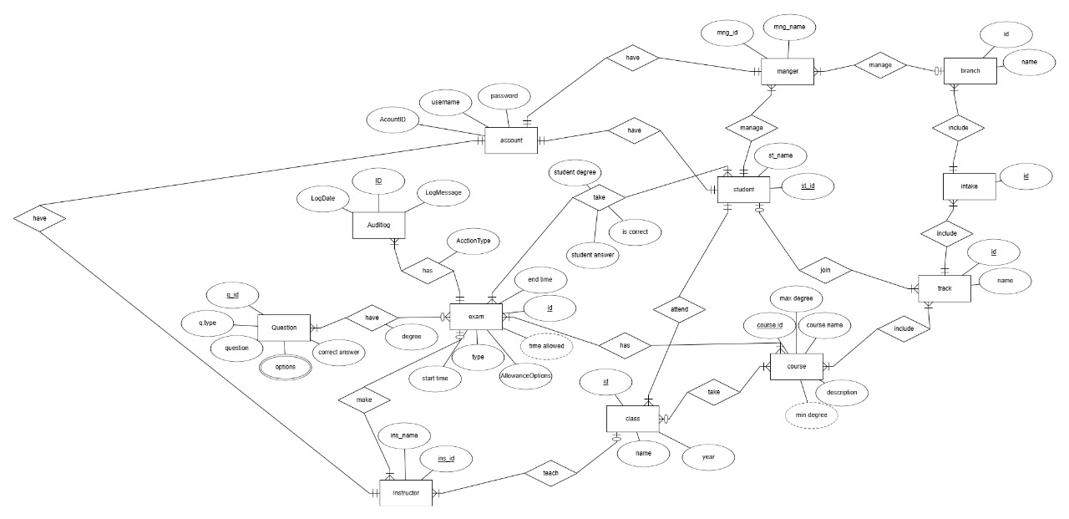
ERD Diagram

Slide 7
Database Design
Courses: Course name, description, max/min degree.
Questions: Question type, correct answers, metadata.
Exams: Exam type, timing, intake, branch, and track.
Results: Student answers and final scores.
Users: Personal data, roles, and permissions.

Slide 8
Schema Representation
Three schemas in our system :
Manager Schema :
Have permissions for INSERT , DELETE ,UPDATE and SELECT
Instructor Schema :
Have Permissions for INSERT , DELETE ,UPDATE and SELECT in Questions and its Answers and the remain tables only SELECT
Student Schema :
Have Permission INSERT to only submit answers and can only SELECT from other tables.

Slide 9
Technical Design
Data Organization:
Implemented using files and filegroups we have 8 file groups.
Naming conventions for clarity.
Performance Optimization:
Indexes for faster queries.
Data Integrity:
Constraints and triggers to validate data.
User Access Control:
SQL users and role-based permissions.
Automation:
Daily backup setup for data safety.

Slide 10
Stored Procedures and Views
Register Account :
Adds a new user account if the username is unique.
Register Student:
Registers a student by creating an account and linking it to student details.
Create Exam:
Creates a new exam with details like type, time, and instructor.
Add Exam Question:
Links questions to an exam and assigns marks for each question.
Submit Student Answer:
Records student answers, checks correctness, and calculates marks.
sp_GetStudentData:
Retrieves student details, including class and track information.

Slide 11
sp_GetStudentExamResults:
Summarizes total scores for students in exams.
sp_AvailableExams :
Lists upcoming exams for an instructor.
sp_GetStudentDegreeInOneExam:
Fetches the degree earned by a student in a specific exam.
sp_StudentHasCorrective:
Checks if a student needs a corrective exam based on their score.
AddOrUpdateCourse:
Updates or creates course details based on existence.

Slide 12
Non-Clustered Indexes
User_Name_Index: On Account(UserName).
Manager_Name_Index: On Manager(ManagerName).
Instructor_Name_Index: On Instructor(InstructorName).
Class_Name_Index: On Class(ClassName).
Student_Name_Index: On Student(StudentName).
Course_Name_Index: On Course(CourseName).
Description_Index: On Course(Description).
QuestionText_Index: On QuestionPool(QuestionText).

Slide 13
Triggers
Hash password :
Hashes passwords in Manager_Schema.Account using SHA1 on INSERT/UPDATE.
RestrictExamDuration:
Prevents exams exceeding 3 hours.
ValidateStudentAnswer:
Update correctness and marks for student answers .

Slide 14
CheckMaxDegree:
Enures max degree that is at least 60
LogsStudentExam:
Logs studentExam submissions to exam auditing table .
LogAccountAndHashPassword:
Combines password hashing and logging for accounts . Detects INSERT or UPDATE operations and logs the corresponding action.

Slide 15

Thank you

